Slide 1

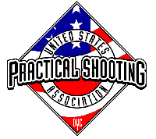
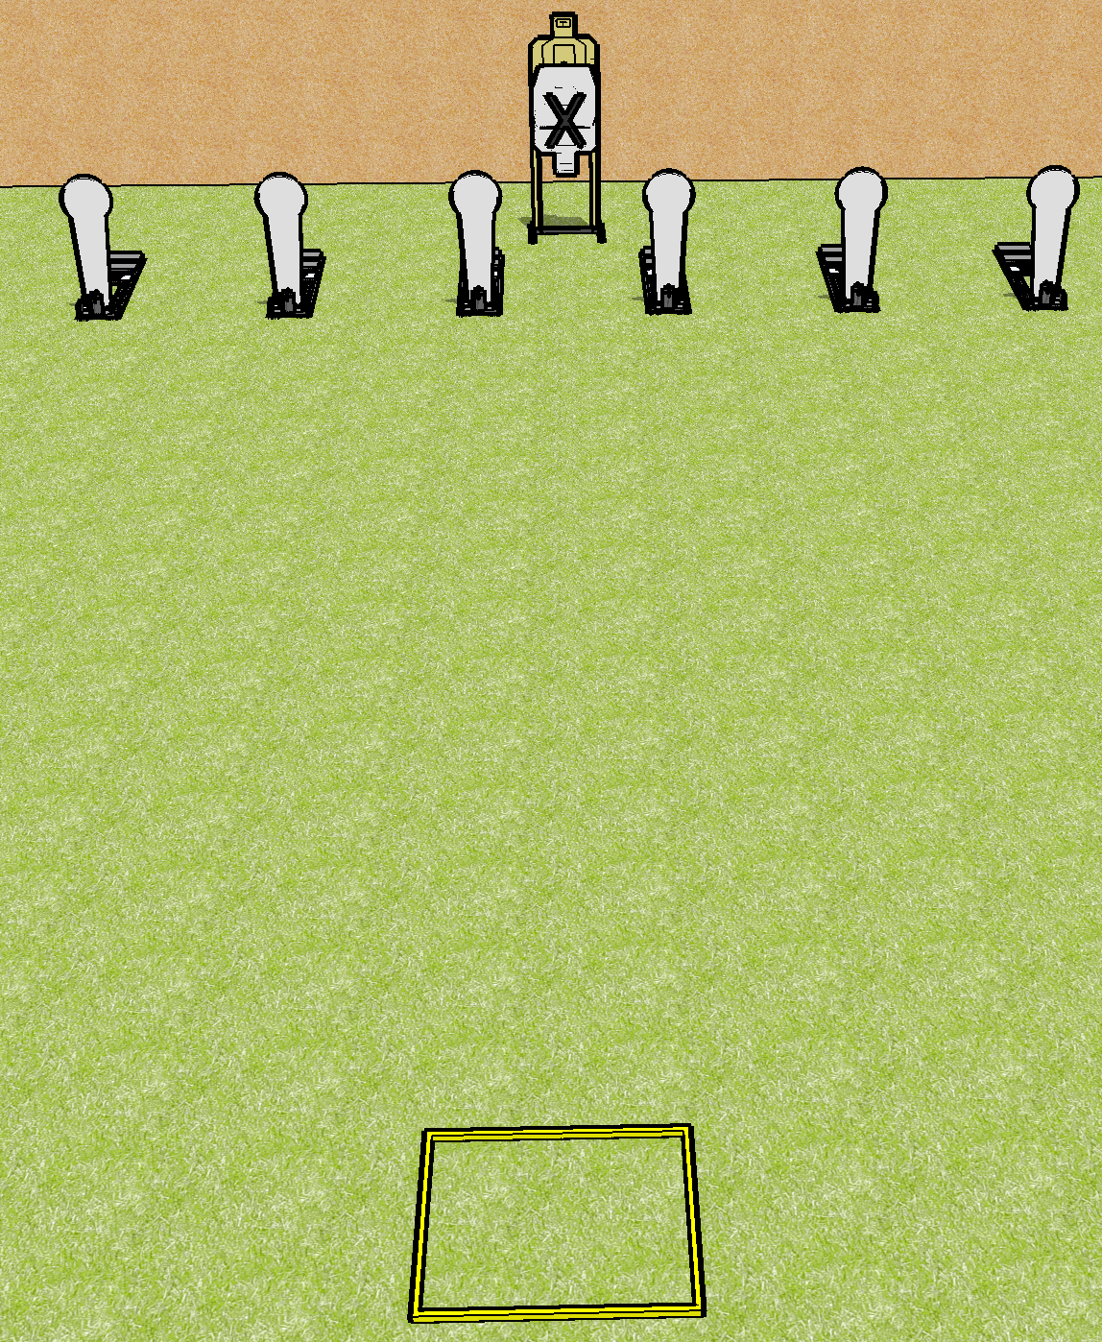
 | Dothan Gun Club – USPSA Match Stick the Reload Course Designer : Drew Coleman
Round Count 10 rounds 1 USPSA 6 colts
Equipment List 1 shooting box 2 targets

Slide 2
Stick the Reload
Written Stage Briefing
Stick the Reload is a 10 round, 50-point, Comstock course of fire. There is 1 USPSA target and 6 steel. The best 4 hits on paper will score and steel must fall to score.
Handgun start position is inside the shooting area facing uprange, wrists above shoulders. Handgun is loaded and holstered.
PCC start position is inside the shooting area, stock on belt. Loaded carbine is held with hands, safety on.
On the audible start signal, engage the steel OR the paper, perform a mandatory reload, then engage the remaining array WEAK HAND ONLY.

